Slide 1

A
PROJECT
REPORT ON
PLACEMENT MANAGEMENT SYSTEM
BY
SUSHMITHA SRINIVAS BINGI
FULL STACK JAVA DEVELOPER
BATCH: 2021-5762
CENTER:BANGALORE S-PRAYAS
UNDER THE GUIDANCE OF,
Chittaranjan Ghosh
(TECHNICAL TRAINER)

Slide 2
Introduction
This project is aimed at developing an online application for the Training and Placement Dept. of the college. The system is an online application that can be accessed throughout the organization and outside as well with proper login provided. This system can be used as an application for the TPO of the college to manage the student information with regards to placement. Students logging should be able to upload their information in the form of a CV. Visitors/Company representatives logging in may also access/search any information put up by Students.

Slide 3
WE developed this project using different kind of application like Java, JSP, Servlets, Hibernate, Thymeleaf and MySQL. It’s a web-based project so I have used HTML,CSS, JavaScript and Bootstrap .
It mainly explains about various actions related to recruiter system in online. You can apply to various kind of jobs available in the portal.

Slide 4
My project include three module :
Admin portal
Recruiter Portal
Student Portal

Slide 5
Purpose
Admin Module:
In Admin Module ,admin the manage all the portal of recruiter and student where all the details are mentioned about the jobs.
The Admin can make change in any portal because they have access to do whatever needed to change.
They can view the applied jobs, view the resume of student and also delete the category of job.

Slide 6
Recruiter Module:
In the recruiter module they upload various kind of jobs from different company’s.
The status of the job application can be changed by them when the candidate applied to.
The recruiter details will also be stored in the portal.

Slide 7
Student Module:
IN THE STUDENT MODULE THEY UPDATE THERE DETAILS IN THE PROJECT.
THEY CAN APPLY FOR JOBS AVAILABLE IN THE PORTAL UPLOADED BY RECRUITER
THEY CAN UPLOAD THEIR PHOTO AND RESUME.
THEY HAVE OPTION TO CHANGE THE PASSWORD, PREVIEW THE RESUME AS WELL.

Slide 8
Software Requirements:
Front end: Java/J2EE technologies (Servlet, JSP), HTML, CSS, JavaScript, Bootstrap, Hibernate.
Back end: MySQL workbench 8.0.23CE.
Middleware/Server: Apache Tomcat v8.5. IDE: Eclipse IDE for Java EE Developers.
Browser: Best result on Google Chrome
Operating System: Window 10.

Slide 9
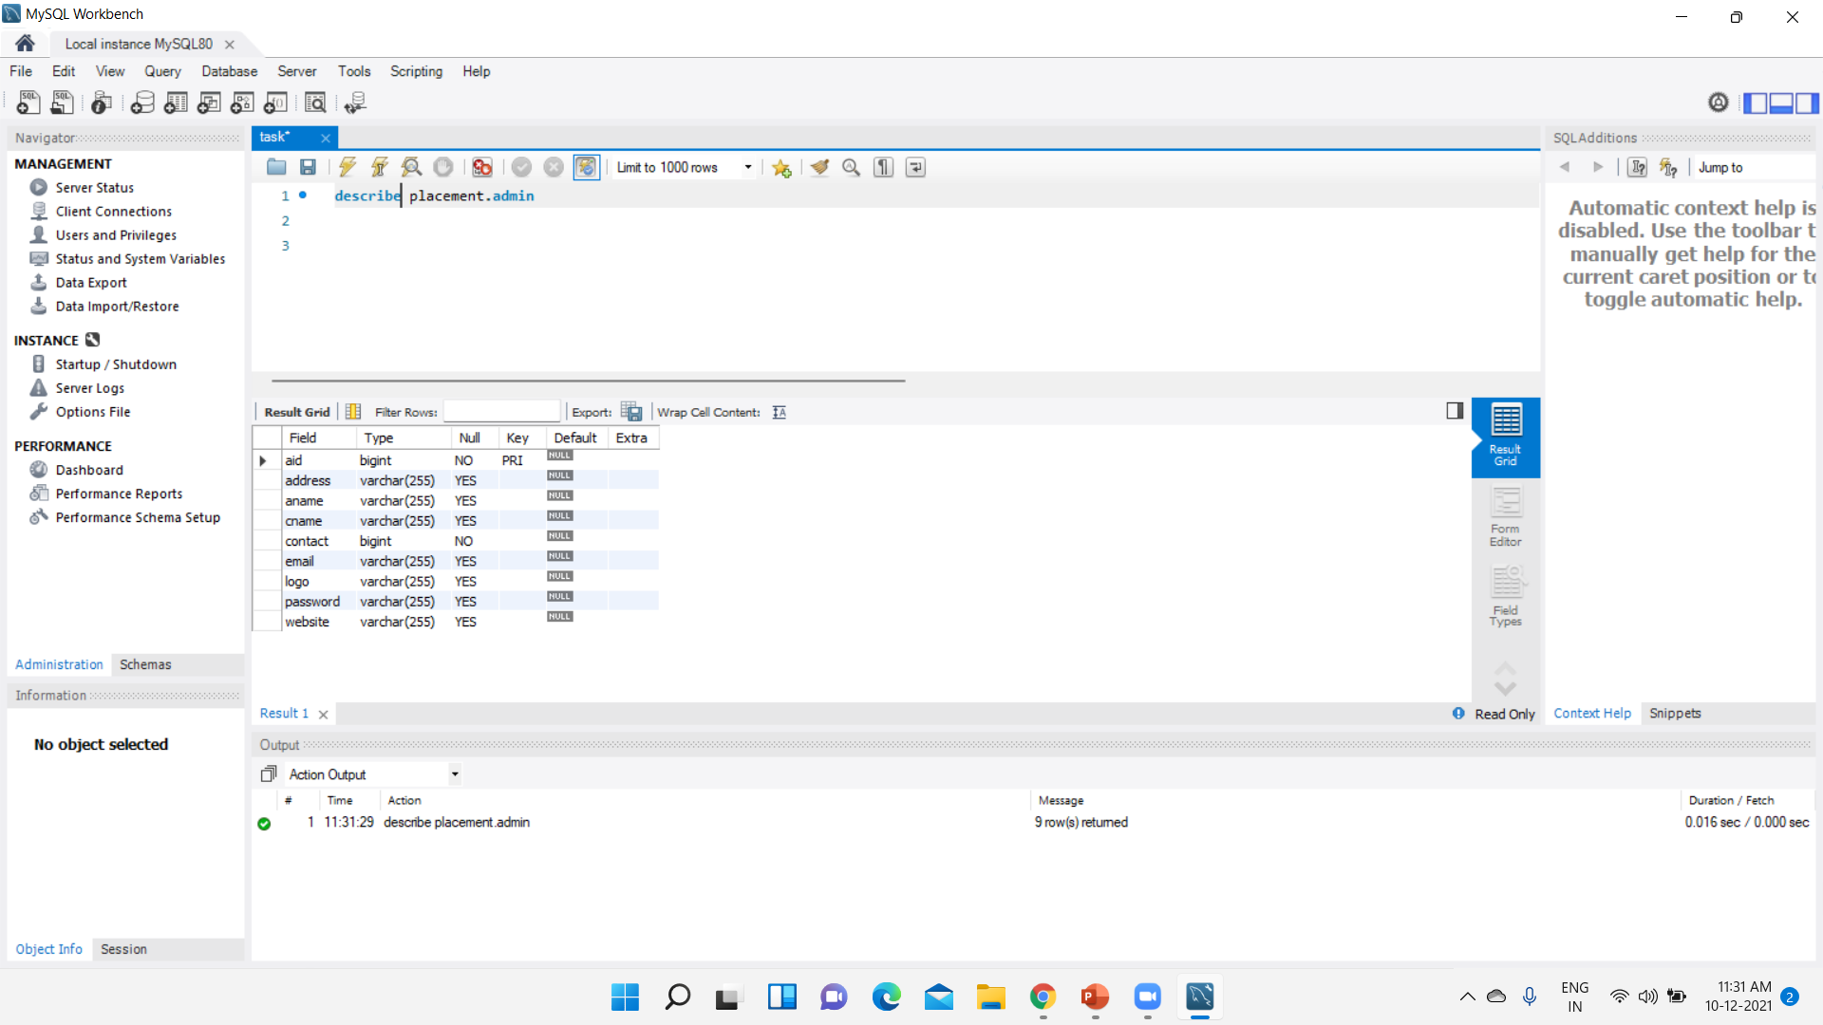
Data Dictionary SCREENSHOTS: DATABASE TABLE FOR ADMIN

Slide 10
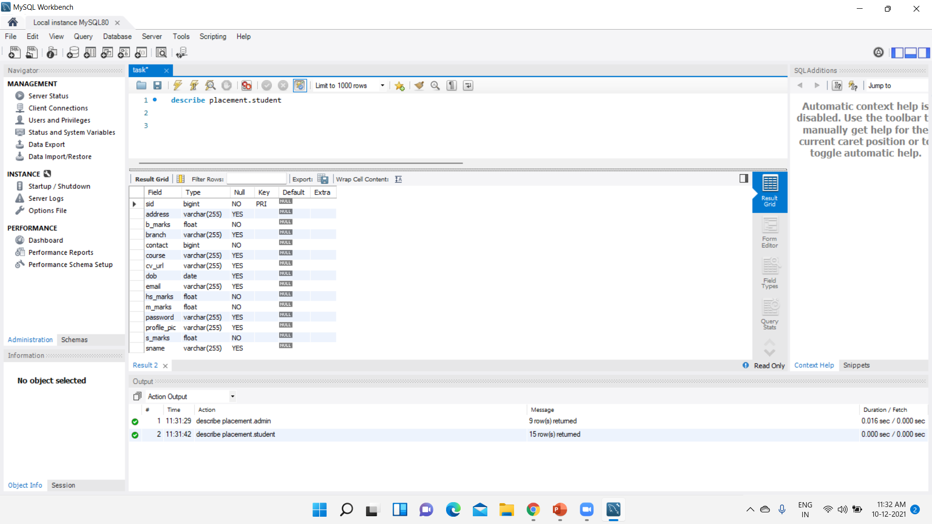
Database table for Student

Slide 11
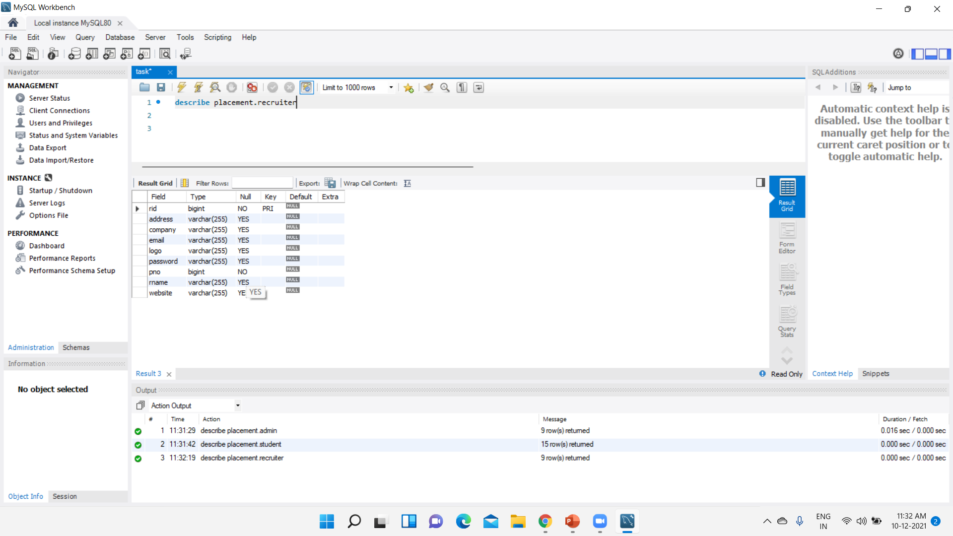
Database table for recruiter

Slide 12
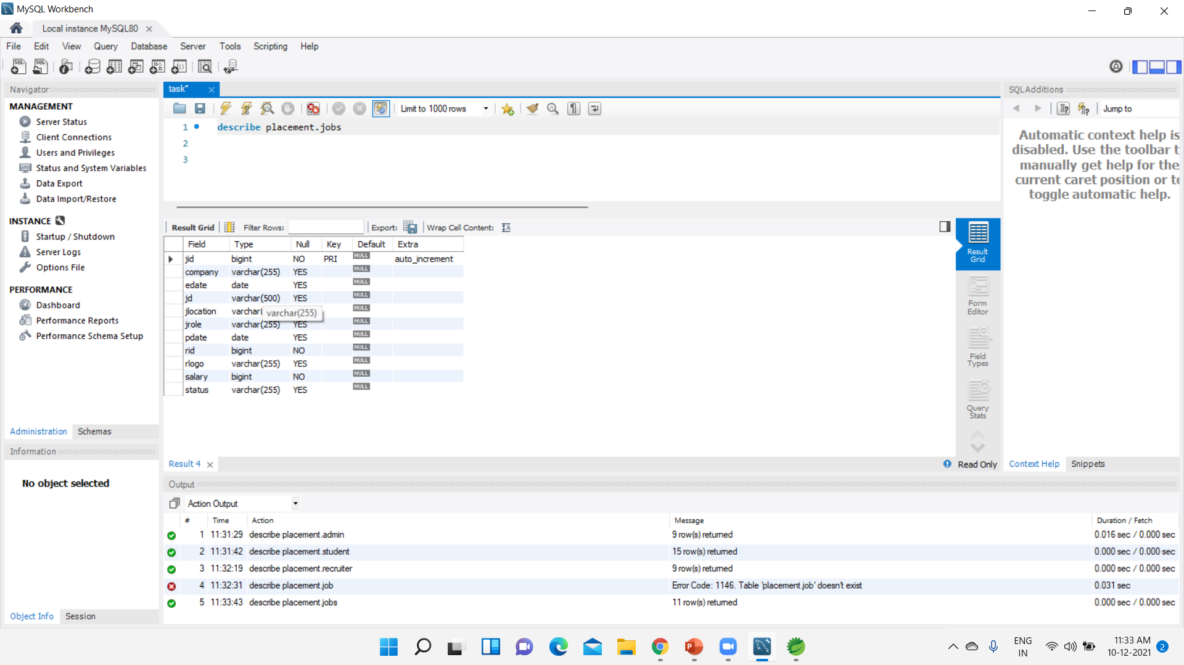
DATABASE TABLE FOR JOBS

Slide 13
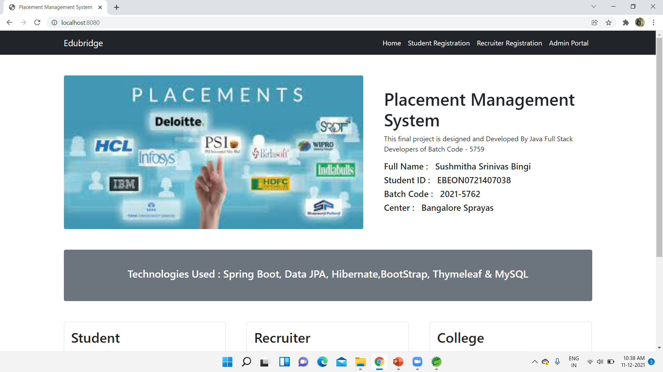
SCREENSHOTS
Home page

Slide 14
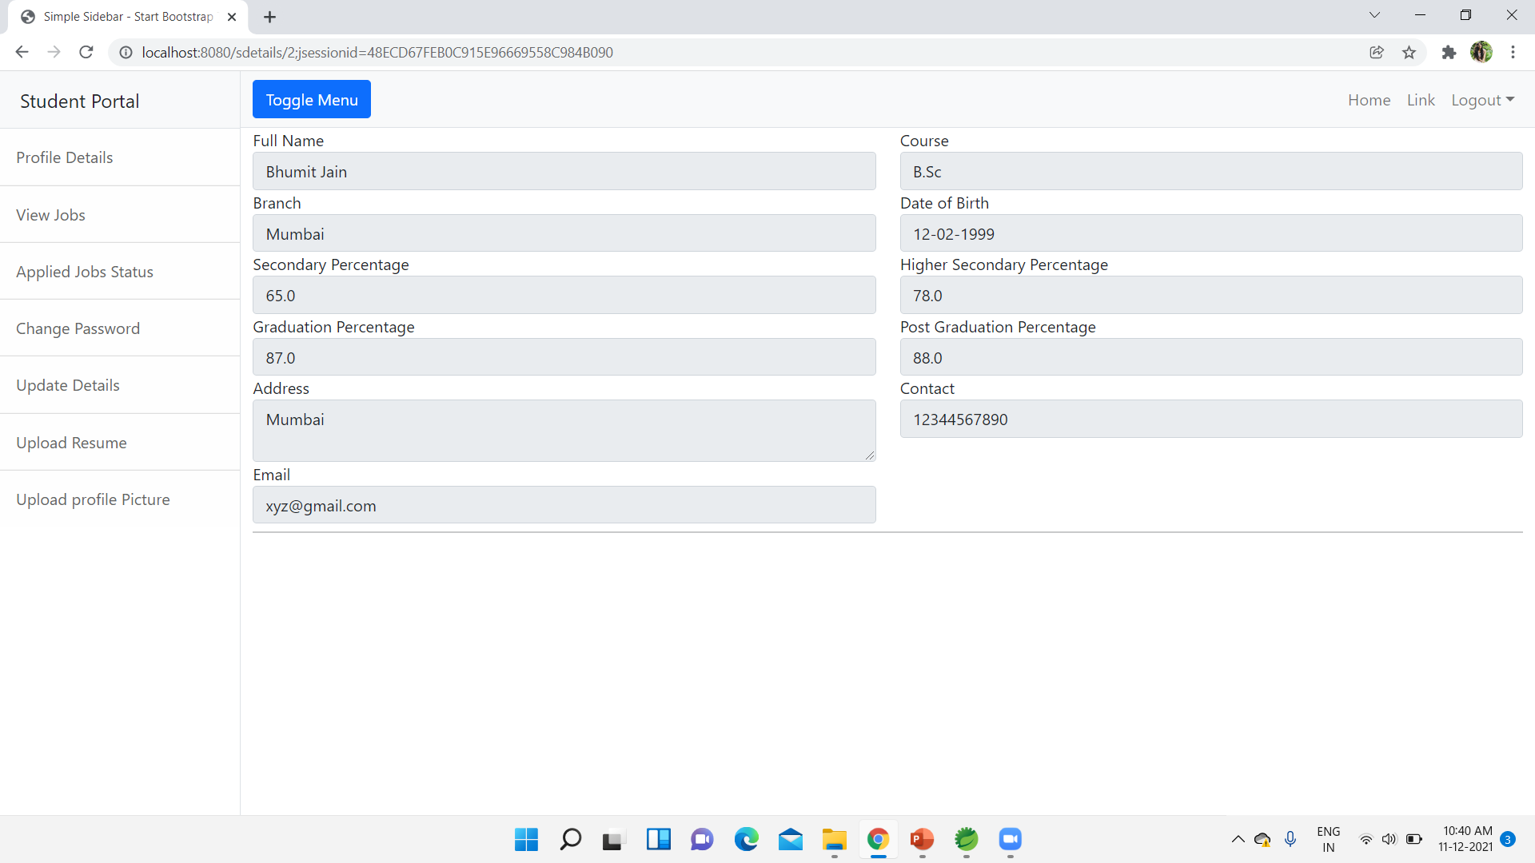
Students details PAGE

Slide 15
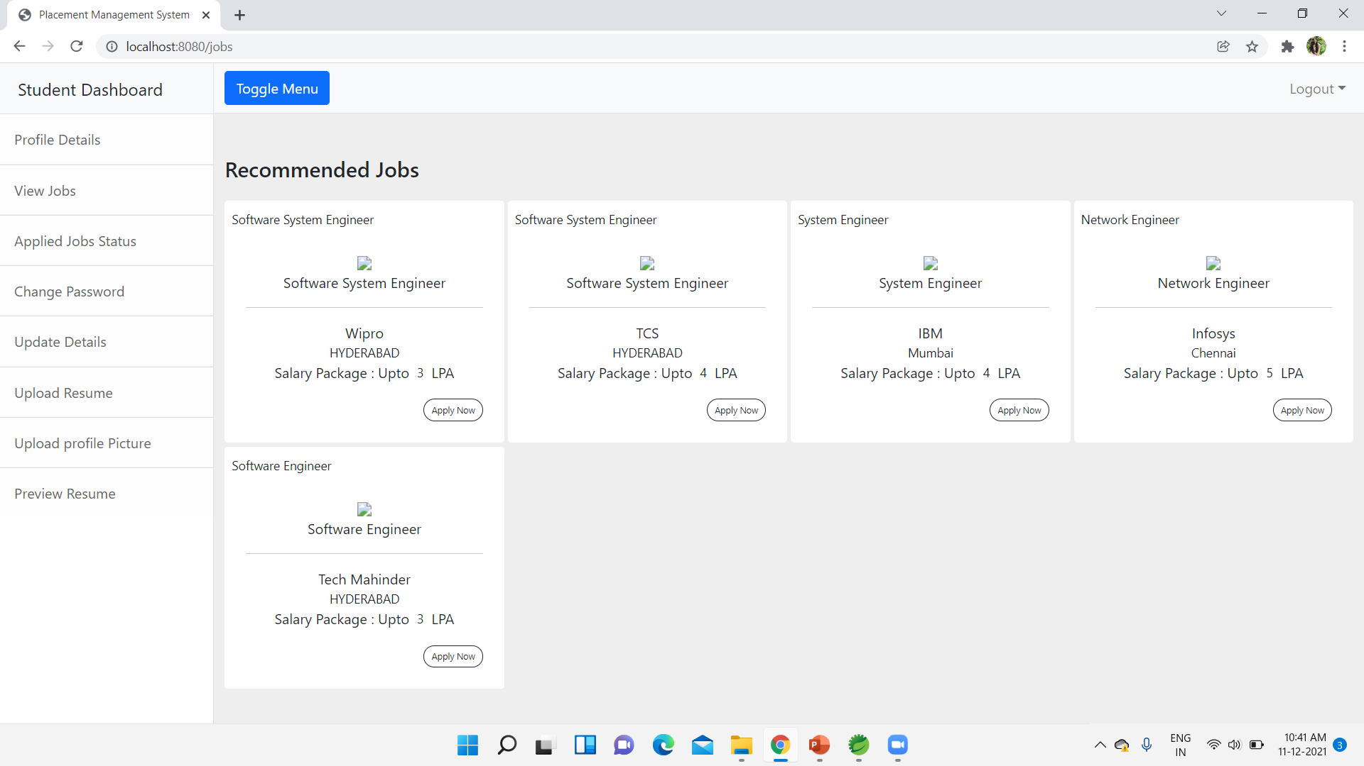
Student view jobs

Slide 16
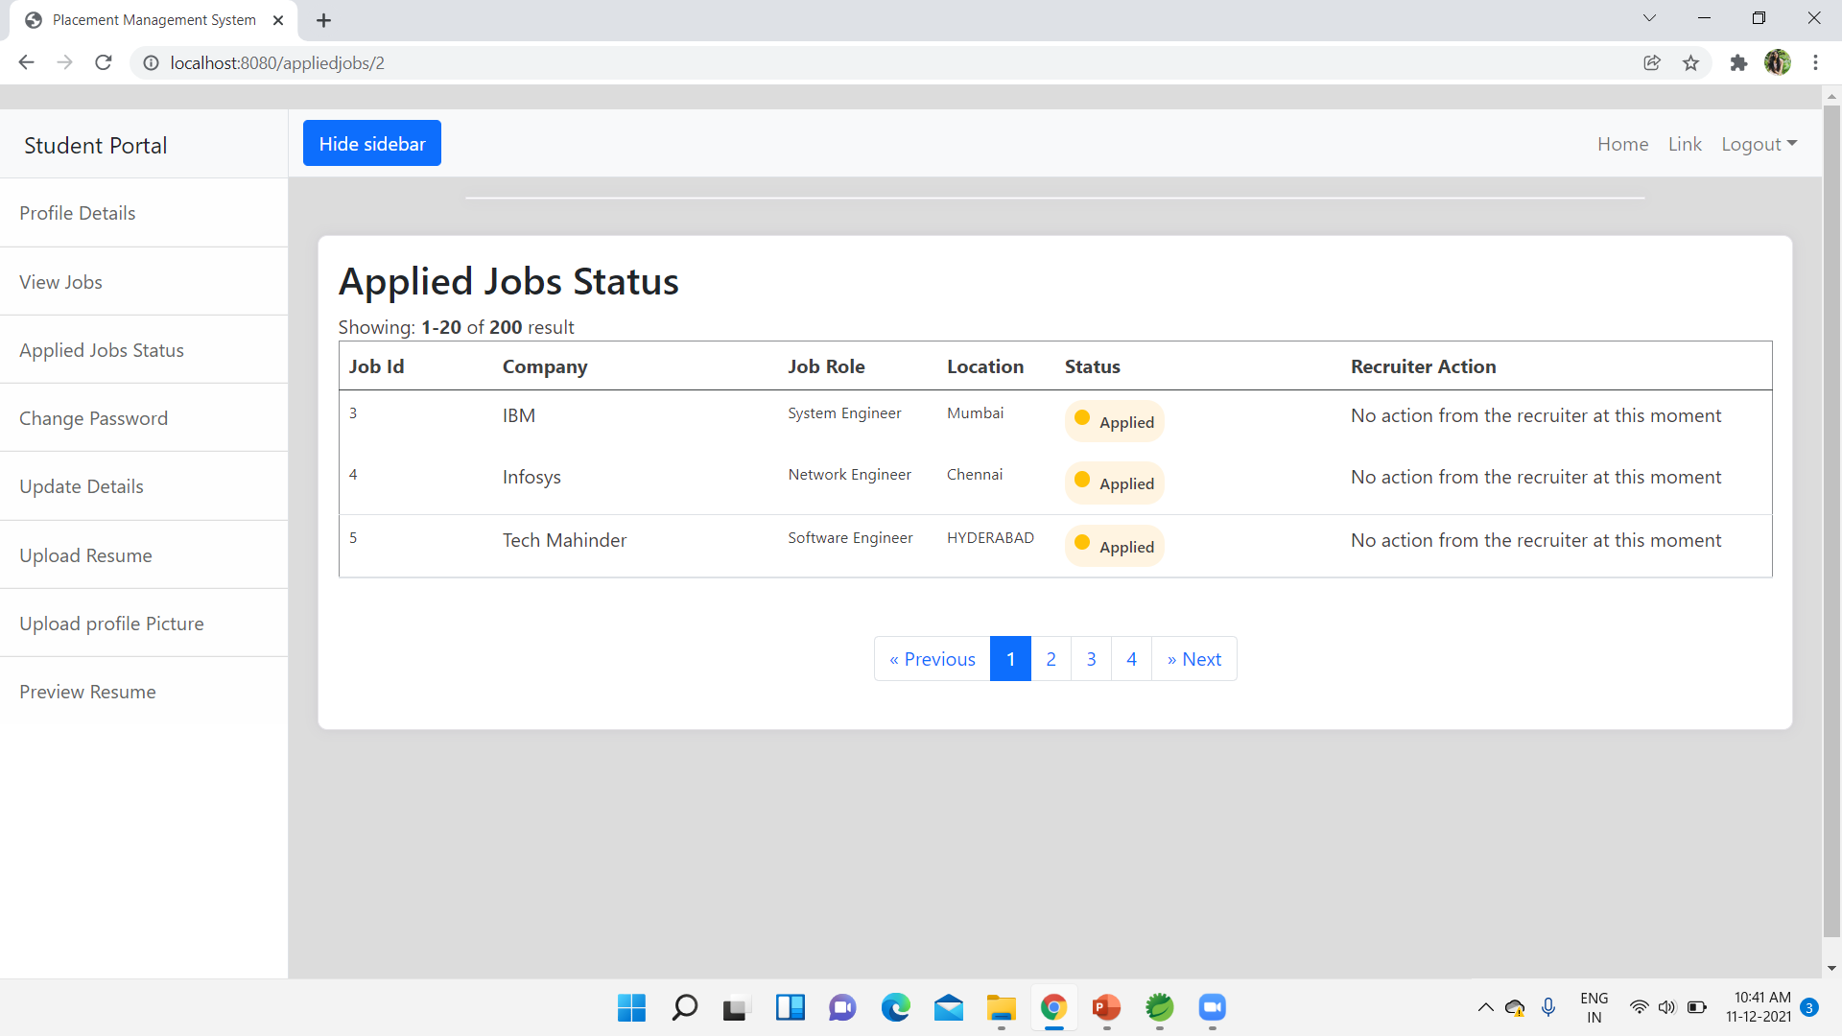
Student Applied jobs PAGE

Slide 17
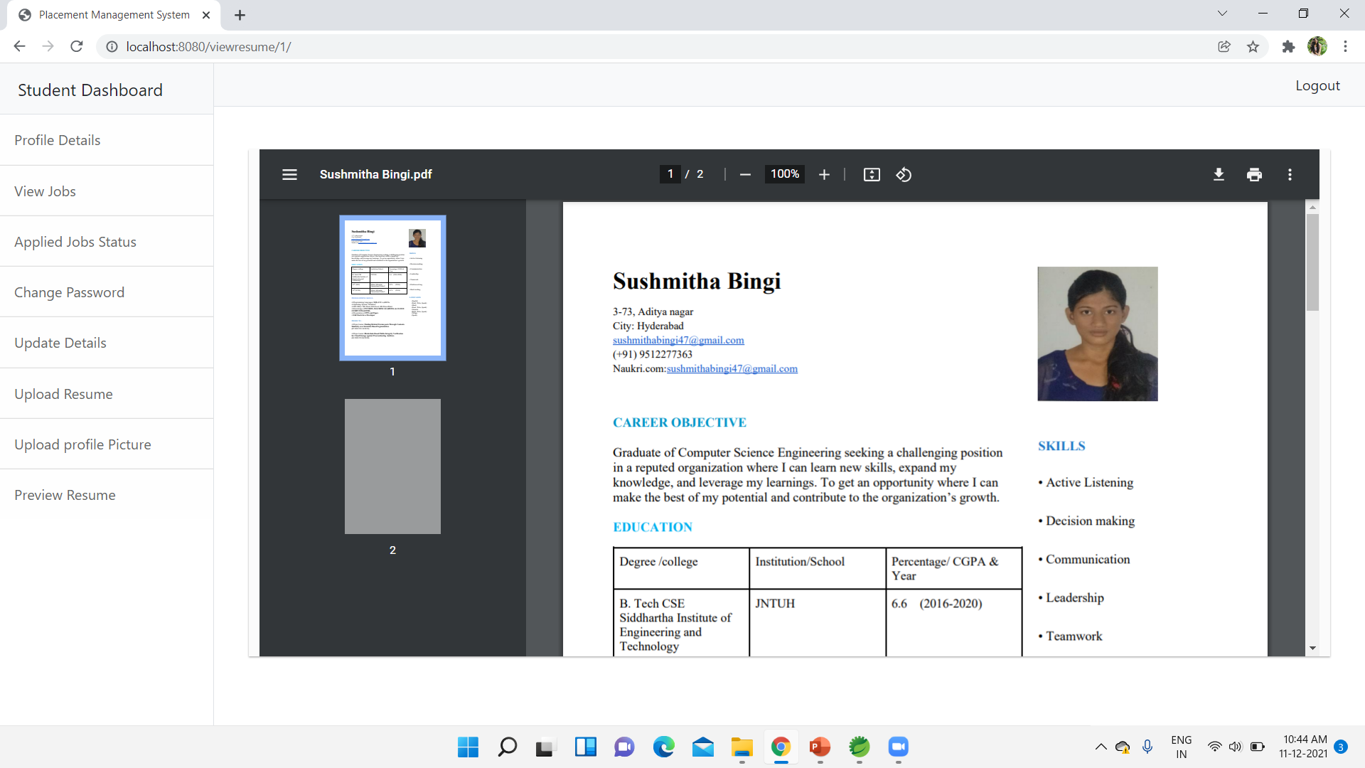
Students PREVIEW RESUME PAGE

Slide 18
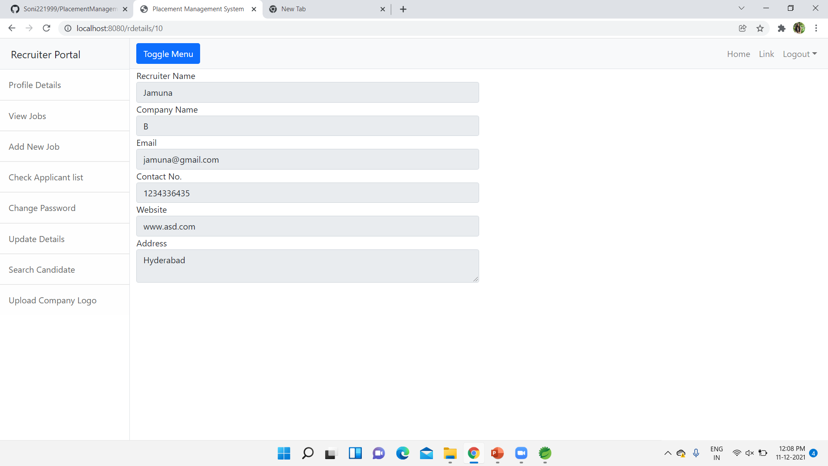
RECRUITER details page

Slide 19
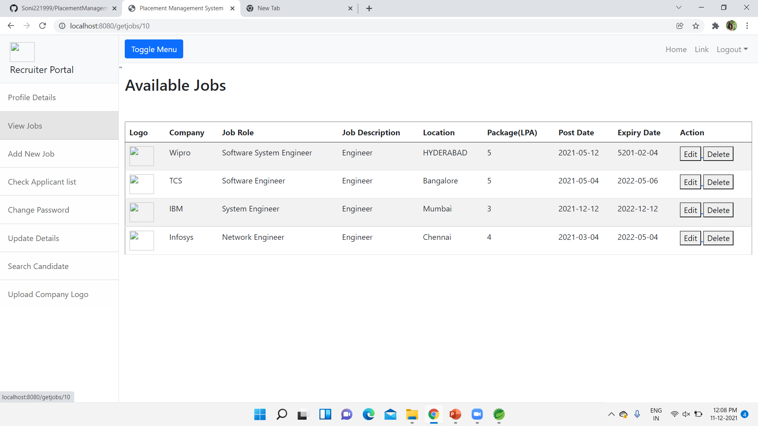
Recruiter view job page

Slide 20
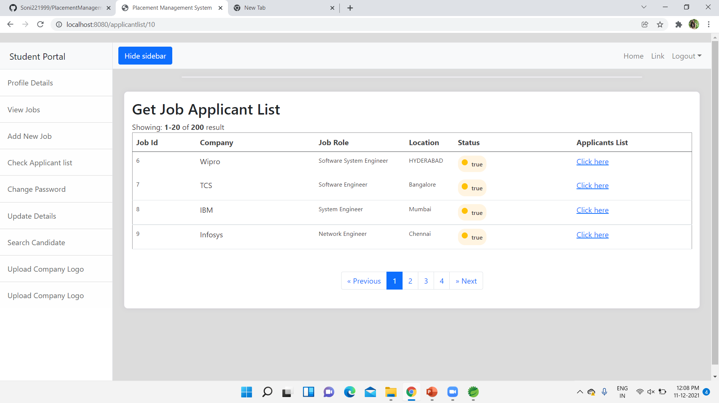
Recruiter applicant list PAGE

Slide 21
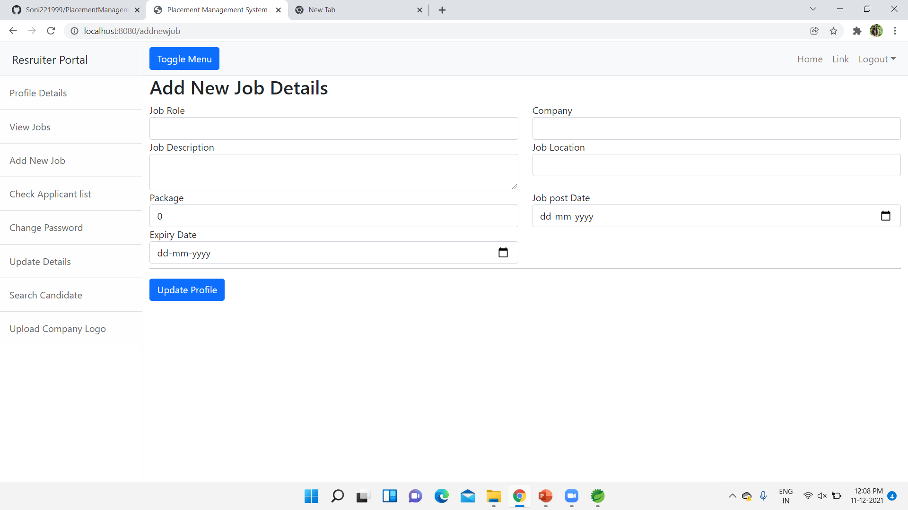
RECRUITER ADD NEW JOB PAGE

Slide 22
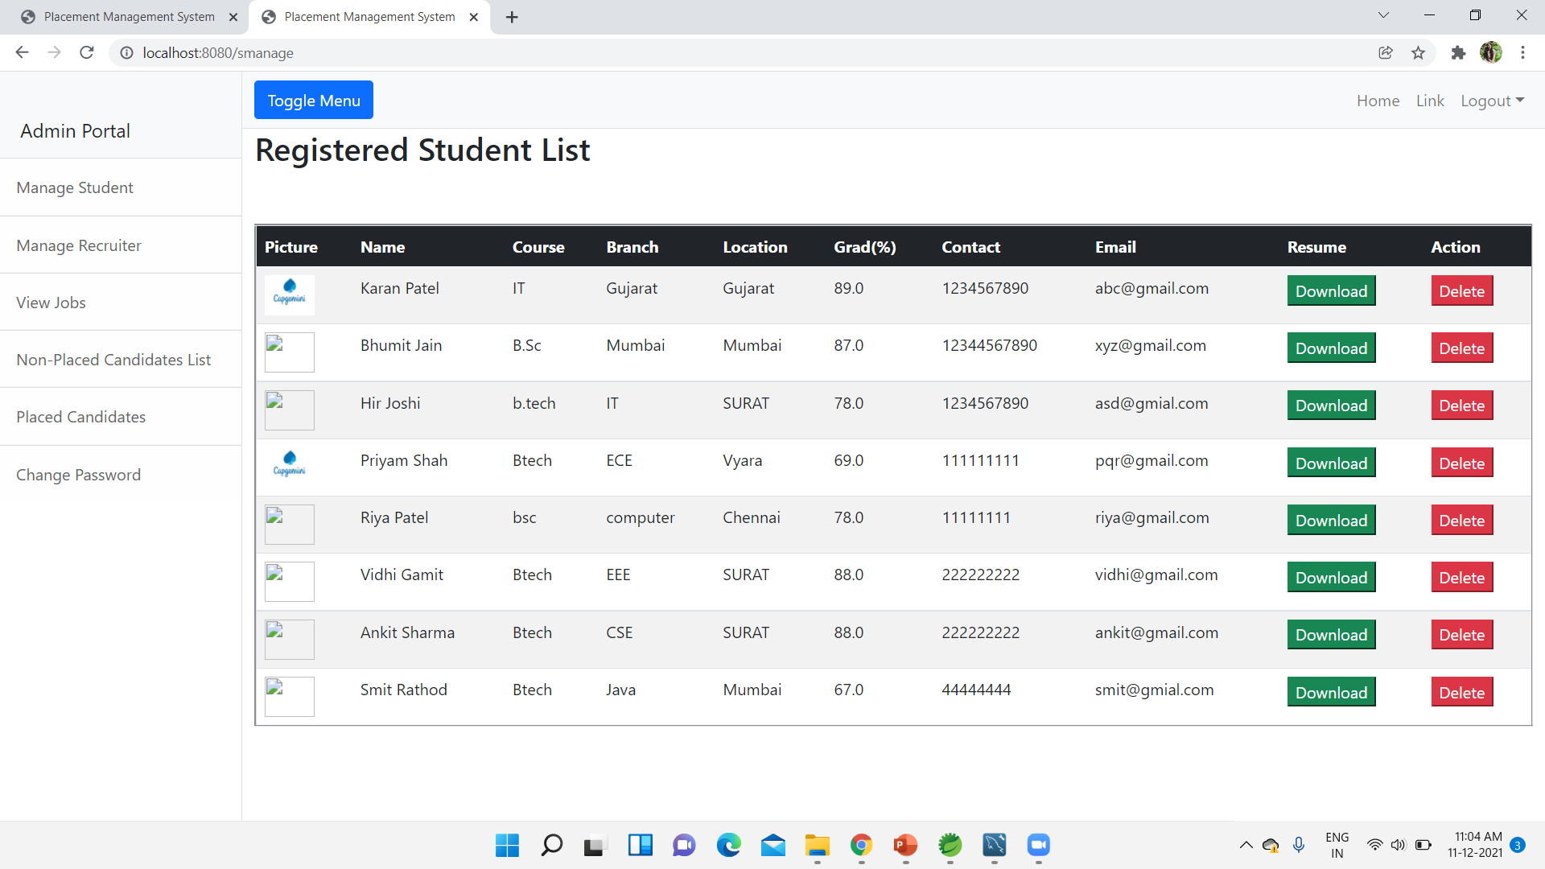
Admin manage Student PAGE

Slide 23
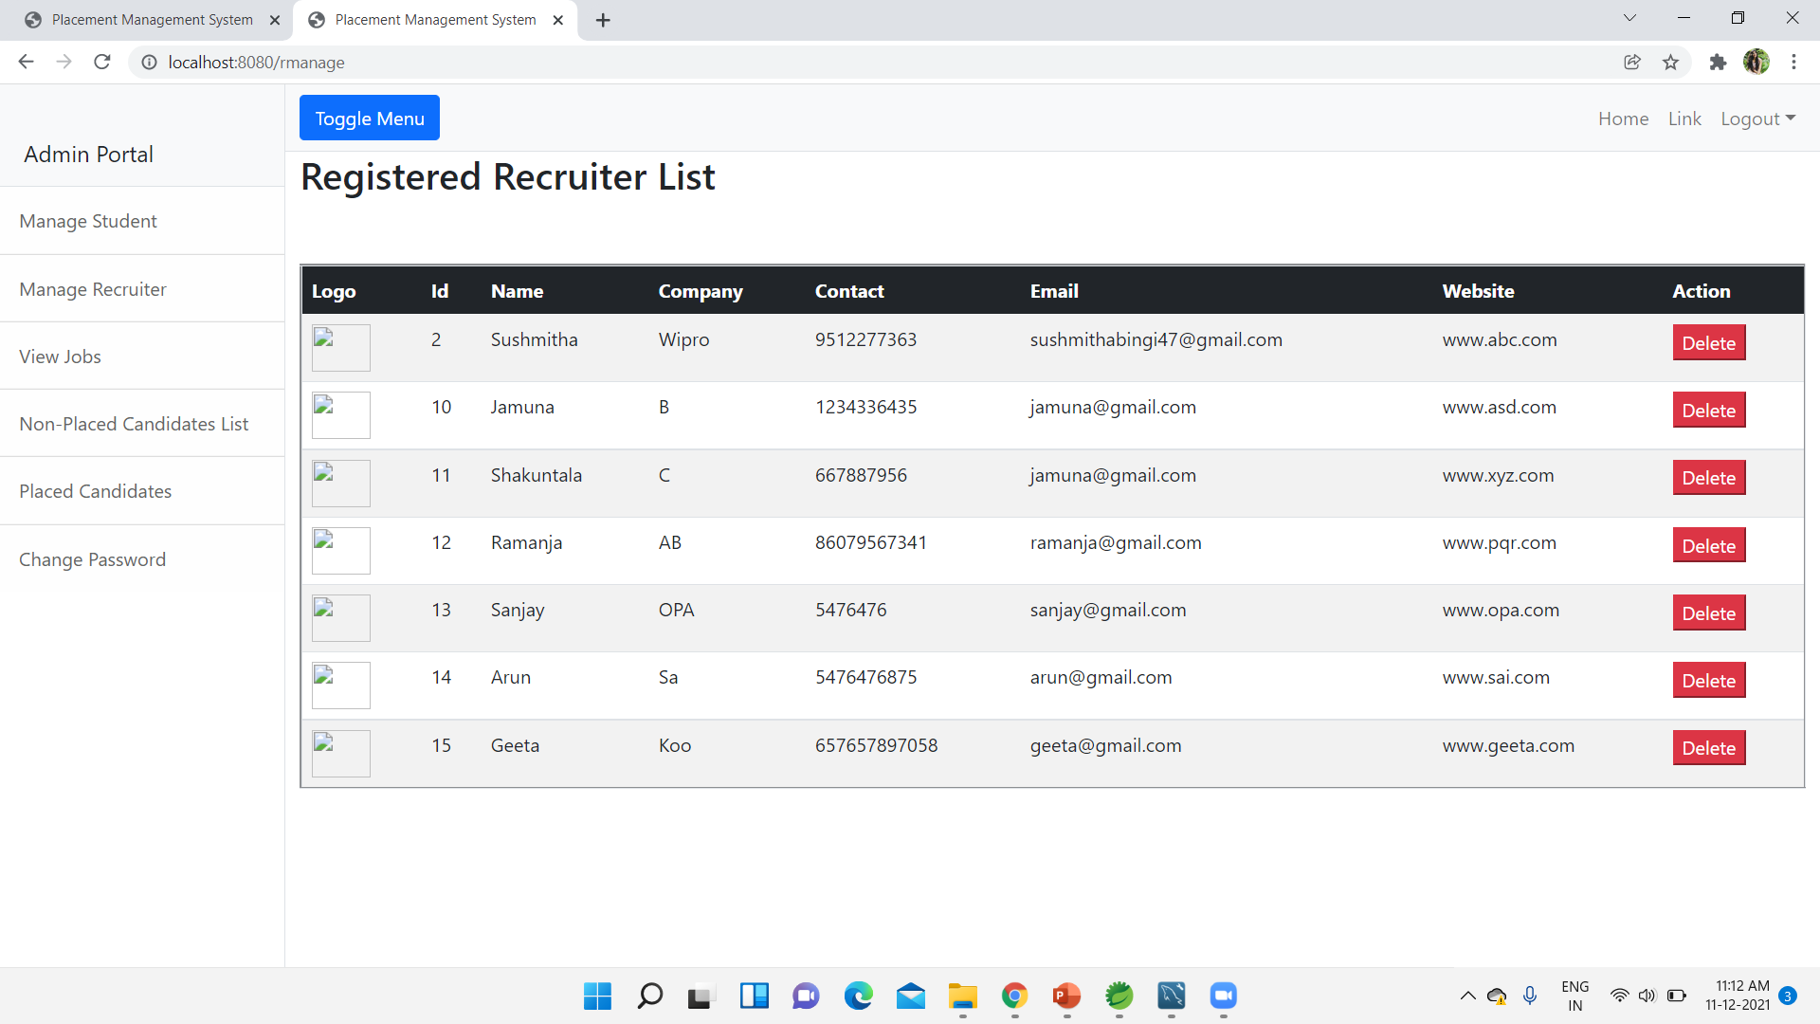
Admin manage recruiter PAGE

Slide 24
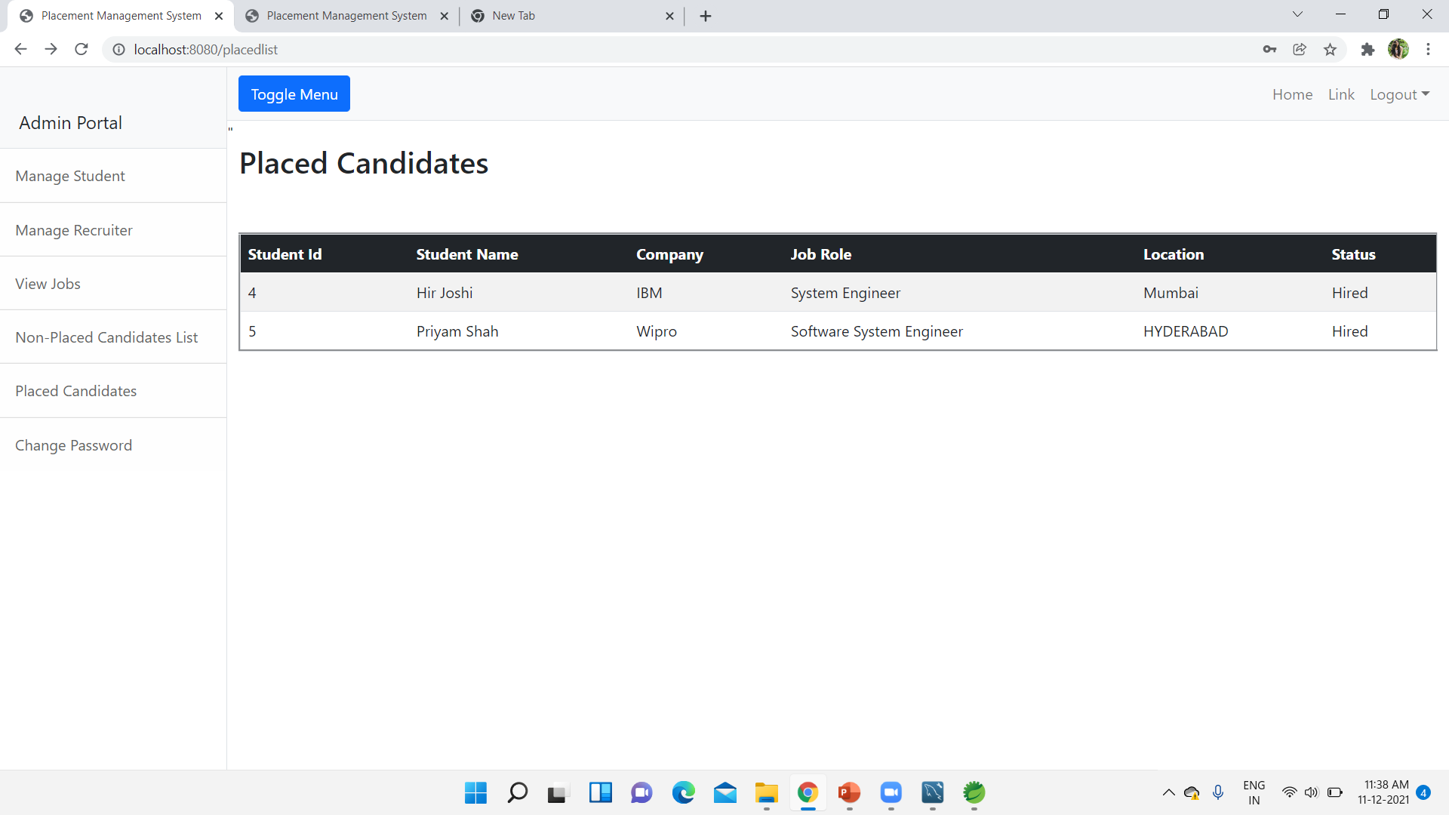
Admin placed candidate PAGE

Slide 25
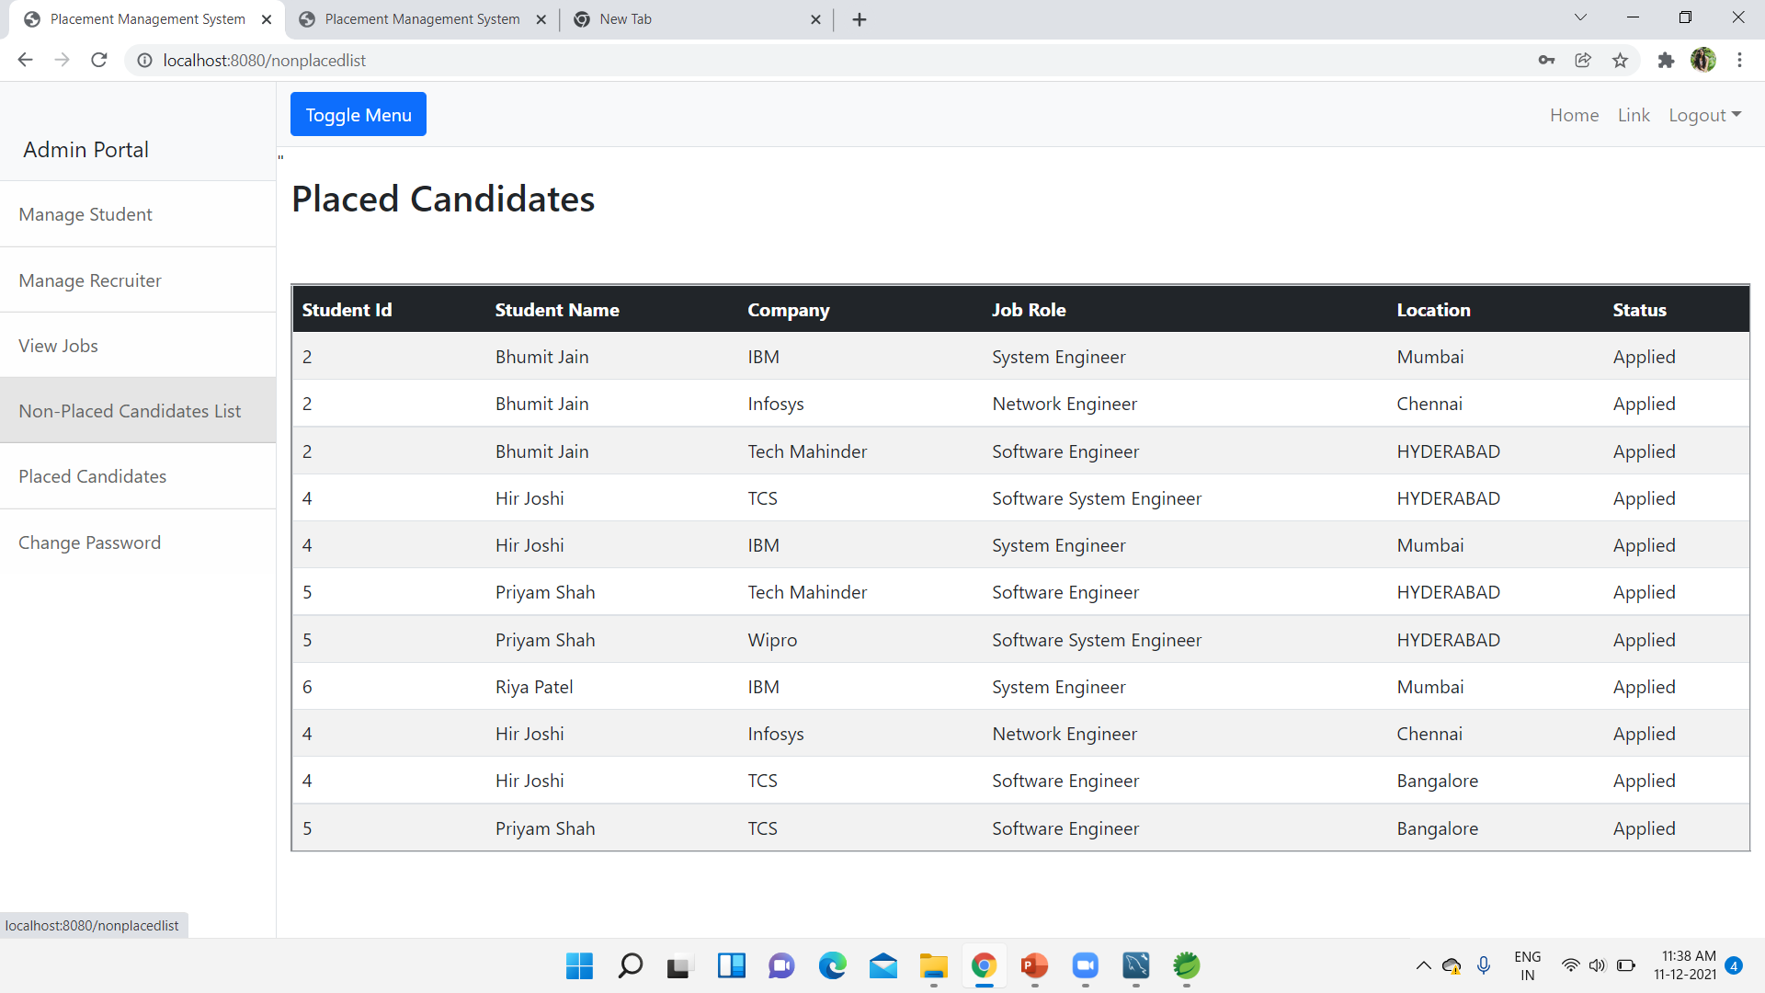
ADMIN NON-placed candidate PAGE

Slide 26
Thank you

